Slide 1
Module

Highest-level programming unit
•
•
•
Modules have classes and functions
Functions have statements
Statements have expressions

Library providing a set of services
• Included functions provide each service
Single container of reusable code

•
•
One place to manage changes
May be shared with other modules
–
Reduces repetition

Slide 2
Module Files

Could be
• Source code file, mod.py, or byte code file, mod.pyc
• Dynamically linked library, mod.dll or mod.so
– Extension modules
Located by a Python search in

•
•
•
•
The current directory
One of the directories contained in PYTHONPATH
The standard library
Directories specified in .pth files
–
Contain pathnames to module files

Slide 3
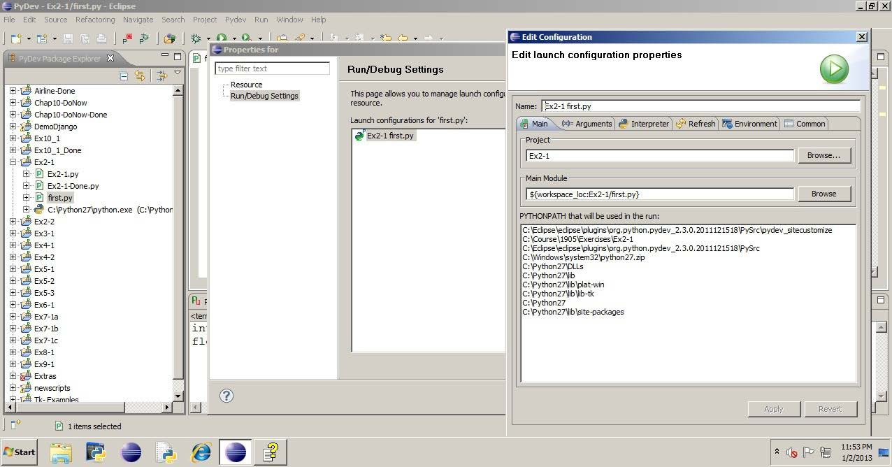
PYTHONPATH in Eclipse

Choose the Properties option for a source-code file
•
Run/Debug Settings

Slide 4
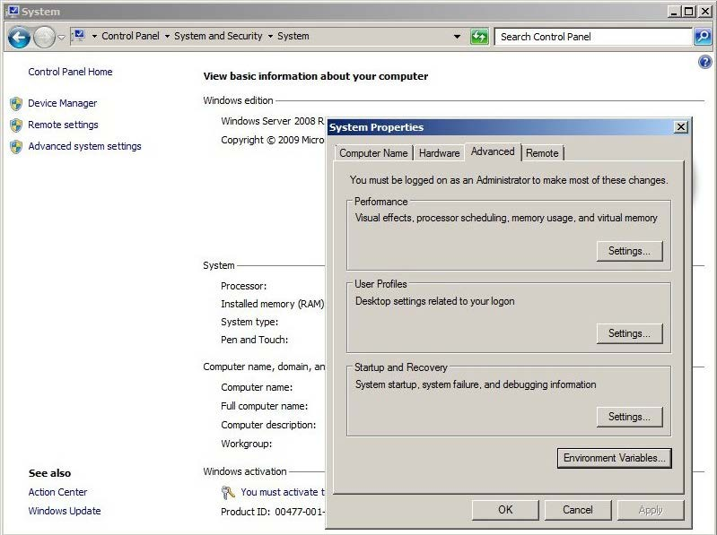
PYTHONPATH in Windows Server 2008

From Control Panel | System and Security | System
•
Environment Variables

Slide 5
The import Statement




Syntax: import modulename
Creates an object of the module’s contents
Enables access to the modulename’s classes and functions
Possibly creates the .pyc byte code file
• If the corresponding .py file is newer, recompile the .pyc
Executed once per process

•
Later imports of same module name use the existing object

Slide 6
Module Execution


All unenclosed statements are executed
Attributes are created
• functions or objects


Occurs in a separate namespace
Creates a module object
• Based on the file name
"""
A simple module
"""
mod1.py
print('starting mod1')
name = 'Guido'
Statements
execute
Attribute
def
printname(count):
print
name
*
count
>>> import mod1
starting mod1
>>> mod1
<module 'mod1' from
Module object created
'mod1.pyc'>

Slide 7
Module Attributes


Reside within the module namespace
Are accessed through a qualified name
•
module.attribute
>>> mod1.name
'Guido'
>>> mod1.printname(3)
GuidoGuidoGuido

Slide 8
Multiple imports
 Qualified attributes reference the proper module
"""
A simple module
"""
mod1.py
"""
Another simple module
"""
print 'starting mod2'
import mod1
mod2.py
print 'starting mod1'
name = 'Guido'
def
printname(count):
def printname():
print
name
*
count
print
mod1.name,
'in
mod2'
>>> import mod1
starting mod1
>>> import mod2
starting mod2
>>> mod1.printname(1)
Guido
>>> mod2.printname()
Guido in mod2
Qualified

Slide 9
Chained imports
 Imported file contains an import statement
• A imports B; B imports C
 Require two levels of qualification to get embedded attributes
• From A, use B.C.attribute
"""
Another simple module
"""
print 'starting mod2'
import mod1
mod2.py
"""
A simple
"""
mod1.py
B
module
C
print 'starting
name = 'Guido'
mod1'
def printname():
print mod1.name,
def
printname(count):
'in
mod2'
print
name
* count
>>> import mod2
starting mod2
starting mod1
>>> mod2.mod1.name
'Guido'
A
Two levels of
qualification

Slide 10
The import
as Statement

Syntax: import modulename as name
•
•
Access contents using name instead of modulename
Identifier name is not restricted by operating system file name
"""
A simple module
"""
print 'starting mod1'
name = 'Guido'
def
printname(count):
print name * count
>>> import mod1 as
starting mod1
>>> m.printname(2)
GuidoGuido
m

Slide 11
Examining Namespace
 The dir() function displays names of module attributes
•
The dict attribute is a dictionary of a module’s objects
>>>
>>>
import math
dir()
Examine the current module
' doc ', ' name__', '__package__', 'math']
[' builtins ',
>>> name__
' main '
Name of the Python
program in execution
Examine the math module
>>> dir(math)
[' doc ', '__name__', '__package ', 'acos',
'acosh'
...
>>> math. name__
Name of the math module
in math. dict .items():
'math'
>>>
...
...
pow
fsum
cosh
for
key, value
print
key,
'\t ===>', value
===>
===>
===>
<built-in
<built-in
<built-in
function
function
function
pow>
fsum>
cosh>
...

Slide 12
Testing the name Attribute

When a module is executed as a program, the name attribute is
set to ' main__'

When imported as a module, the name attribute is set to the module
name
def main_program():
...
...
...
#
#
logic to test a module
when executed as
a
program
if
__name__
== '__main__':
main_program()

Slide 13
from Statement

Copies named attribute into the current namespace
• No attribute qualification needed

Syntax: from
module import attributes
"""
A simple module
"""
print 'starting mod1'
name = 'Guido'
def printname(count):
print
name *
count
>>>
from mod1
import
printname
starting mod1
>>> printname(2)
GuidoGuido
Single
attribute
Unqualified
name

Slide 14
from Statement
 from module import *
• Imports all attributes into the current namespace
• Not a best practice
– May corrupt the namespace
"""
A simple
"""
>>> from mod1 import *
starting mod1
>>> printname(3)
GuidoGuidoGuido
module
print 'starting
name = 'Guido'
mod1'
>>> name
Guido
All attributes
def
printname(count):
Unqualified
print
name
*
count

Slide 15
Namespace Corruption

Affects same named objects within the namespace
• Later assignments replace previous values

from module import
• PEP 8
* is discouraged in Python style guide
>>> name
>>> name
'Lars'
>>> from
starting
>>> name
'Guido'
= 'Lars'
mod1
mod1
import
*
"""
A simple module
"""
print 'starting mod1'
name = 'Guido'
name in
current
namespace
changed
def printname(count):
print name * count

Slide 16
Packages


Directory hierarchy of module files
Allow module hierarchy to follow the directory structure
• Instead of flat structure of modules
• Group related modules as needed
– System architecture, service, Python version, etc.

Packages are usually downloaded as compressed archives
• Extraction into a directory structure provides
–
–
–
README file for instructions
setup.py file for installation
Package python files

Packages installation
python setup.py
install

Slide 17
Downloading Packages

Python Package Index is a package repository with tutorials
•
•
•
For downloading and installing
For creating and uploading
http://pypi.python.org/pypi

pip is a fundamental tool for package management
• Installs packages and dependencies from the repository
• Removes packages and dependencies
pip
install
packagename

Slide 18
Package Directory Structure



Base directory of the package must be in the Python search path
Multiple levels of subdirectories are allowed
Each subdirectory must also contain
•
•
Its .py or .pyc module files
An init__.py file
–
Executes when that directory’s modules are first imported

Slide 19







Package import


Syntax: import pkg.dir
Each . separates a level of directory structure
• No operating-system–specific separators allowed
pkg must be beneath a root directory within the search path
dir must have the init__.py file


pkg
• May be an empty file
Runs the code in all init__.py files within the

path
• Creates an object of the module’s contents
Each directory becomes a namespace
dir
...

module.py
def fun:
...
variable=x

Slide 20




Accessing Package Modules

import pkg.dir.module
• Names must be fully qualified
– pkg.dir.module.fun()
– pkg.dir.module.variable
from pkg.dir import module
• Names may be qualified by module
– module.fun() or module.variable

pkg
dir

from pkg.dir.module import
fun
•
Unqualified names are allowed
–
fun()
module.py
def fun:
...
variable=x

Slide 21
Standard Library



Collection of modules that come with Python
Not part of the language itself
Interfaces to access common utilities
•
Operating system
– File system and utilities
Database access
Date and time information and measurement
GUI and network application development
Regular expression pattern matching
Archiving and compression
And more!
•
•
•
•
•
•

Slide 22
The sys Module
Reference

Contains functions and variables that are used by Python itself
sys.version
sys.path
sys.modules
sys.platform
sys.executable
String of Python version
List containing search path for modules
Dictionary of currently loaded modules
String of operating system type
String of pathname to Python interpreter
>>> sys.version
'2.7.2 (default, Jun 12 2011, 15:08:59)
(AMD64)]'
>>> sys.path[0]
'C:\\Python27\\Lib\\idlelib',
>>> sys.path[9]
'C:\\Python27\\lib\\site-packages']
[MSC
v.1500
64
bit

Slide 23
Command-Line Arguments
Reference

Are passed into the program when it is started
sys.argv
List of command-line argument strings passed
import sys
argtest.py
print 'arg count is', len(sys.argv)
for word in sys.argv:
print 'found', word
C:\> C:\Python27\python
arg count is 4
argtest.py
this
is
it
found
found
found
found
argtest.py
this
is
it

Slide 24
The os and subprocess Modules
Reference

Contains functions and variables used to portably query and interact
with processes within the operating system
os.environ
os.getpid()
os.kill()
subprocess.call()
Dictionary of environment variables
Function returning an integer process ID
Function terminating a process
Function executing an operating-system command
>>> os.environ['PYTHONPATH'].split(';')
['C:\\Python27', 'c:\\Python27\\Lib\\site-packages\\django']
>>>
subprocess.call(['ping',
'localhost'])

Slide 25
The os Module and Running Commands
Reference
 The subprocess.Popen() class handles process creation
>>>
>>>
...
>>>
...
...
import
pipe =
subprocess
subprocess.Popen(['ping', 'localhost'], shell=True,
stdout=subprocess.PIPE)
for
pingline in pipe.stdout:
print pingline
Pinging
WIN2008_64 [::1] with 32 bytes of
data:
Reply
Reply
Reply
Reply
from
from
from
from
::1:
::1:
::1:
::1:
time<1ms
time<1ms
time<1ms
time<1ms
Output shortened
Ping statistics
for
::1:
4, Received
Packets: Sent =
= 4, Lost
= 0 (0%
loss),

Slide 26
The os and os.path Modules and
the
File
System
Reference

Contain functions and variables used to
•
Manage the file system
os.sep
os.getcwd()
os.chdir()
os.listdir()
os.mkdir()
os.rmdir()
os.remove()
String of directory path component separator
Returns a string of the current directory
Changes the current directory
Returns a list of directory contents
Creates a directory
Removes a directory
Removes a file
•
Query the file system
os.path.isdir()
os.path.isfile()
os.path.getsize()
Returns a Boolean, tests if path is a directory
Returns a Boolean, tests if path is a file
Returns the size in bytes

Slide 27
The glob Module and File Names
Reference

Provides pattern matching on file names
?
[ … ]
*
Matches any single character
Matches any single character in the set
Matches any number of any character

glob() function returns a list of matching file names

Slide 28
File System Management Example
Reference
>>>
>>>
>>>
>>>
>>>
>>>
...
import
orig =
backup
os, glob, subprocess
r'C:\Course\1905\Data'
= r'C:\Course\1905\backupcsv'
os.mkdir(backup)
os.chdir(orig)
for file in glob.glob('*.csv'):
subprocess.call(['copy',
file,
backup],
shell=True)

Slide 29
Regular
Expression
Special
Characters
Reference
^, $
.
[ ], [^ ]
*
+
?
|
( )
\
Anchor pattern to beginning or ending of line
Any single characters
Any single character in set or not in set
Zero or more of preceding regular expression
One or more of preceding regular expression
Zero or one of preceding regular expression
Or
Group
Following character is not special

Slide 30
Regular Expression Escape Sequences
Reference

Alternate method to describe select text patterns
\d
\D
\w
\W
\s
Any single base-10 digit
Any single character not a base-10 digit
Any single alphanumeric character
Any single nonalphanumeric character
Any single whitespace character

Slide 31
Using Backslash \
Reference

Python uses \ as part of escape sequences in strings
• '\n' for newline, '\t' for tab
Escape sequence \\ represents a single backslash
Regular expression containing backslash must be escaped


•
•
•
'\\d' matches a digit
'\\\\' matches a literal backslash
'\\+' matches one or more backslashes

Raw strings do not honor escape sequences
•
Specified as r'string'
–
–
–
r'\d' matches a digit
r'\\' matches a literal backslash
r'\+' matches one or more backslashes

Slide 32
The re Module
Reference

Provides pattern-matching functions
• Regular expressions are symbolic notation to match text patterns
– May contain regular characters and special characters
match(pattern,string)
• Finds the pattern at the beginning of the string argument
• Returns a match object with start() and end() methods that return the indices
search(pattern,string)


•
•
Finds the pattern anywhere in the string argument
Returns a match object with start() and end() methods

Slide 33
String Matching
Example
Reference
>>>
>>>
>>>
>>>
0
>>>
4
>>>
>>>
import
course
re
= 'This is Python Programming'
ans = re.match(r'[A-Z]\w+', course)
ans.start()
ans.end()
ans = re.search(r'[Pp]\w+', course)
course[ans.start():ans.end()]
String slice
Python

Slide 34
Extracting Substrings
Reference
 findall(pattern,string)
•
•
Finds all occurrences of the pattern
Returns a list of matching strings
>>>
>>>
data = 'This is the perfect Python
re.findall(r'[Pp]\w+',data)
Programming
string'
['perfect',
'Python',
'Programming']

Slide 35

Using Regular Expressions
Do Now
1.
2.
Access the Python interpreter console using the
button
Import the regular expression module and make the following
assignment:
>>> import re
>>> text = 'http://127.0.0.1:8000/cgi-bin/helloworld.py'
3.
Use regular expression functions to match and display the following
strings:
a.
b.
c.
One or more consecutive letters
One or more consecutive digits
Only the consecutive digits immediately following a colon, ':'

Slide 36
Using Regular Expressions: A Solution
Do Now
>>> text = 'http://127.0.0.1:8000/cgi-bin/helloworld.py'
>>> re.findall(r'[a-zA-Z]+', text)
['http', 'cgi', 'bin', 'helloworld',
'py']
>>> re.findall(r'[0-9]+', text)
['127', '0', '0', '1',
>>> re.findall(r'\d+',
['127', '0', '0', '1',
'8000']
text)
'8000']
>>> loc = re.search(r':[0-9]',text)
>>> re.findall(r'\d+',text[loc.start():])
['8000']

